Slide 1
DSA 503
ANALYSIS OF VARIANCE

Slide 2

THE F DISTRIBUTION
Definition
The F distribution is continuous and skewed to the right.
The F distribution has two numbers of degrees of freedom: df for the numerator and df for the denominator.
The units of an F distribution, denoted F, are nonnegative.

Slide 3

THE F DISTRIBUTION

Slide 4
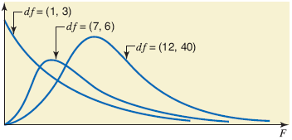
Figure 12.1 Three F distribution curves.

Slide 5
Example 12-1
Find the F value for 8 degrees of freedom for the numerator, 14 degrees of freedom for the denominator, and .05 area in the right tail of the F distribution curve.

Slide 6
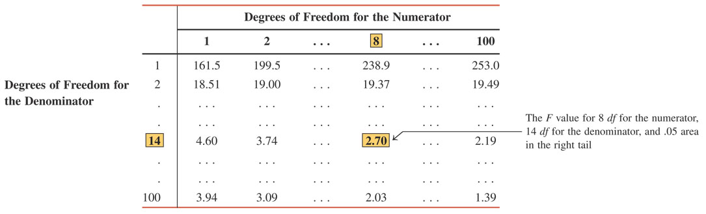
Table 12.1 Obtaining the F Value From Table VII

Slide 7
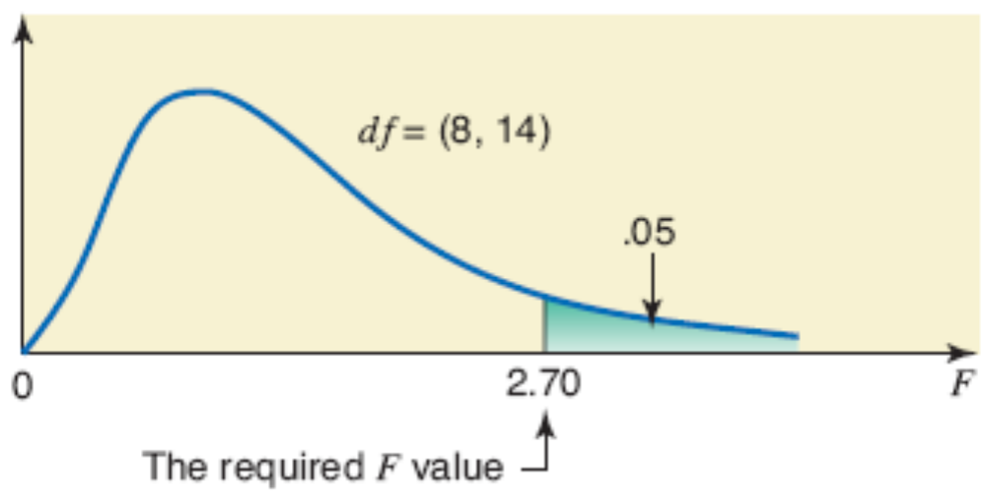
Figure 12.2 The critical value of F for 8 df for the numerator, 14 df for the denominator, and .05 area in the right tail.

Slide 8

ONE-WAY ANALYSIS OF VARIANCE
Calculating the Value of the Test Statistic
One-Way ANOVA Test

Slide 9
ONE-WAY ANALYSIS OF VARIANCE
Definition
ANOVA is a procedure used to test the null hypothesis that the means of three or more populations are equal.

Slide 10
Assumptions of One-Way ANOVA
The following assumptions must hold true to use one-way ANOVA.
  The populations from which the samples are drawn are (approximately) normally distributed.
  The populations from which the samples are drawn have the same variance (or standard deviation).
  The samples drawn from different populations are random and independent.

Slide 11
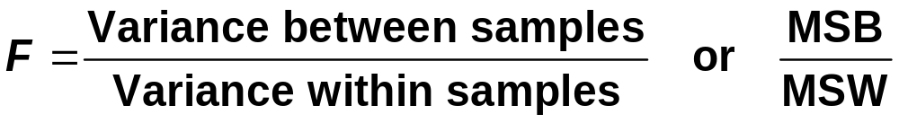
Calculating the Value of the Test Statistic
Test Statistic F for a One-Way ANOVA Test
The value of the test statistic F for an ANOVA test is calculated as
The calculation of MSB and MSW is explained in Example 12-2.

Slide 12
Example 12-2
Fifteen fourth-grade students were randomly assigned to three groups to experiment with three different methods of teaching arithmetic. At the end of the semester, the same test was given to all 15 students. The table gives the scores of students in the three groups.

Slide 13
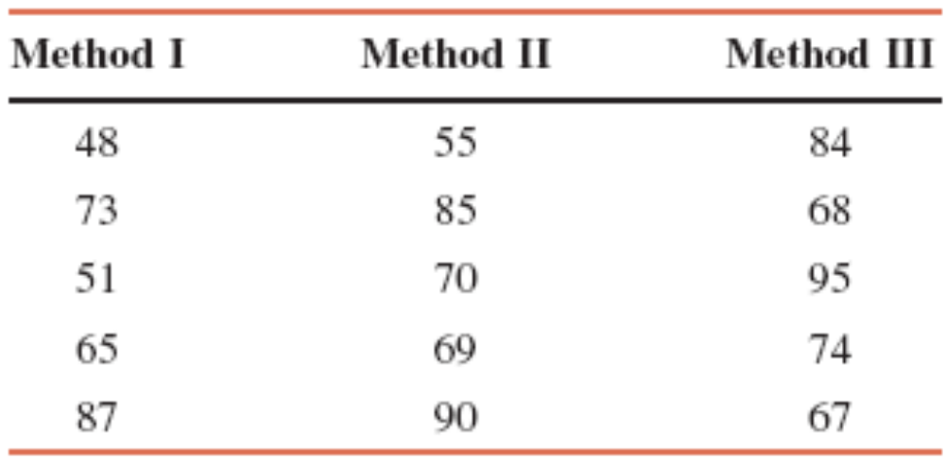
Example 12-2
Calculate the value of the test statistic F. Assume that all the required assumptions mentioned in Section 12.2 hold true.

Slide 14
Example 12-2: Solution
Let
  x = the score of a student
  k = the number of different samples (or treatments)
  n_{i} = the size of sample i
  T_{i} = the sum of the values in sample i
  n = the number of values in all samples
  = n₁ + n₂ + n₃ + . . .
  Σx = the sum of the values in all samples = T₁ + T₂ + T₃ + . . .
  Σx² = the sum of the squares of the values in all samples

Slide 15
Example 12-2: Solution
To calculate MSB and MSW, we first compute the between-samples sum of squares, denoted by SSB and the within-samples sum of squares, denoted by SSW. The sum of SSB and SSW is called the total sum of squares and is denoted by SST; that is,
SST = SSB + SSW
The values of SSB and SSW are calculated using the following formulas.

Slide 16
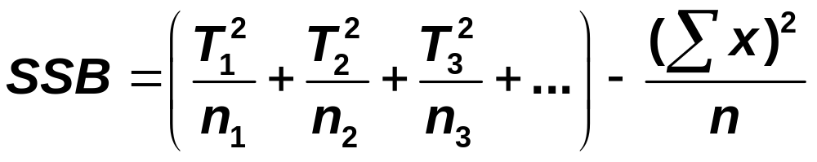
Between- and Within-Samples Sums of Squares
The between-samples sum of squares, denoted by SSB, is calculates as

Slide 17
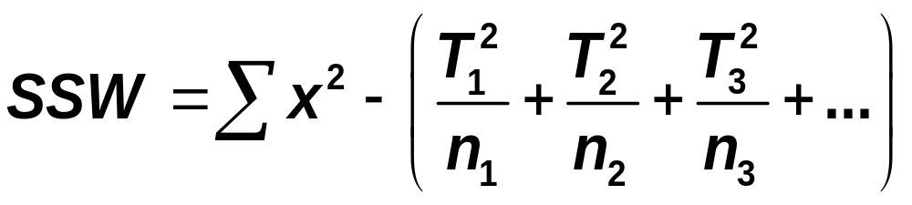
Between- and Within-Samples Sums of Squares
The within-samples sum of squares, denoted by SSW, is calculated as

Slide 18
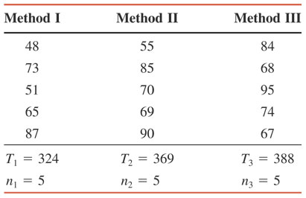
Table 12.2

Slide 19
Example 12-2: Solution
∑x = T₁ + T₂ + T₃ = 324+369+388 = 1081
n = n₁ + n₂ + n₃ = 5+5+5 = 15
Σx² = (48)² + (73)² + (51)² + (65)² + (87)² + (55)² + (85)² + (70)² + (69)² + (90)² + (84)² + (68)² + (95)² + (74)² + (67)²
= 80,709

Slide 20
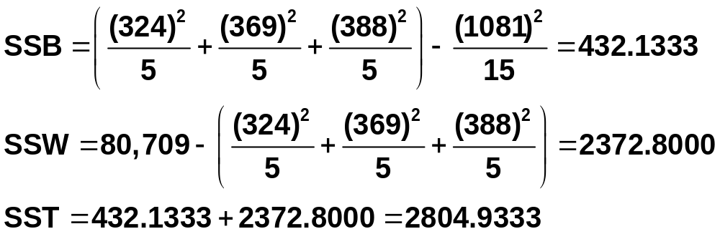
Example 12-2: Solution

Slide 21
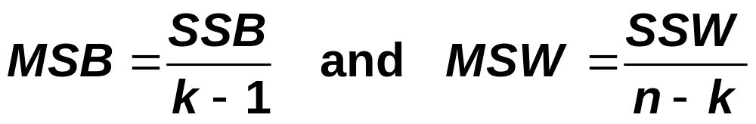
Calculating the Values of MSB and MSW
MSB and MSW are calculated as
where k – 1 and n – k are, respectively, the df for the numerator and the df for the denominator for the F distribution. Remember, k is the number of different samples.

Slide 22
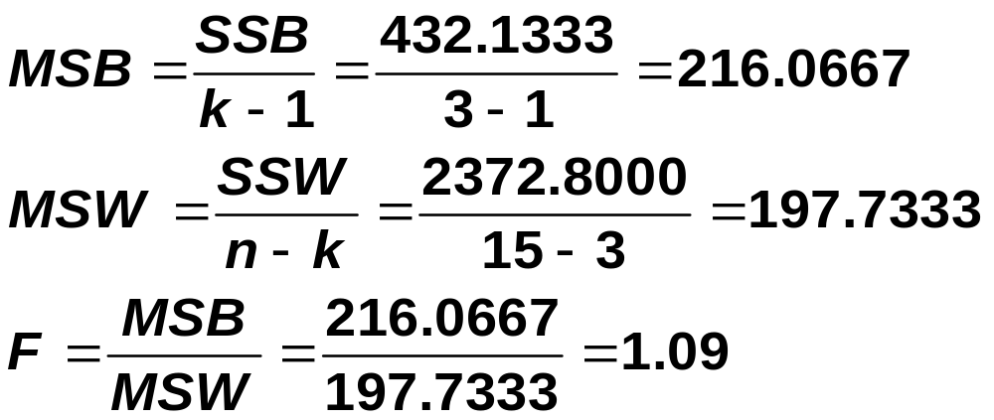
Example 12-2: Solution

Slide 23
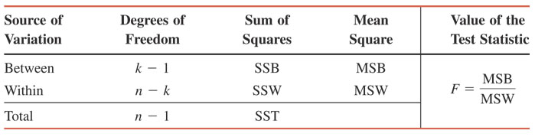
Table 12.3 ANOVA Table

Slide 24
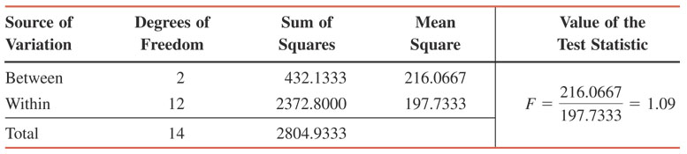
Table 12.4 ANOVA Table for Example 12-2

Slide 25
Example 12-3
Reconsider Example 12-2 about the scores of 15 fourth-grade students who were randomly assigned to three groups in order to experiment with three different methods of teaching arithmetic.
At the 1% significance level, can we reject the null hypothesis that the mean arithmetic score of all fourth-grade students taught by each of these three methods is the same? Assume that all the assumptions required to apply the one-way ANOVA procedure hold true.

Slide 26
Example 12-3: Solution
Step 1: Hypothesis
H₀: μ₁ = μ₂ = μ₃ (The mean scores of the three groups are all equal)
H₁: Not all three means are equal
Step 2: Distribution:
F distribution

Slide 27
Example 12-3: Solution
Step 3: Critical value + regions
α = .01
A one-way ANOVA test is always right-tailed
df for the numerator = k – 1 = 3 – 1 = 2
df for the denominator = n – k = 15 – 3 = 12
The critical value of F is 6.93

Slide 28
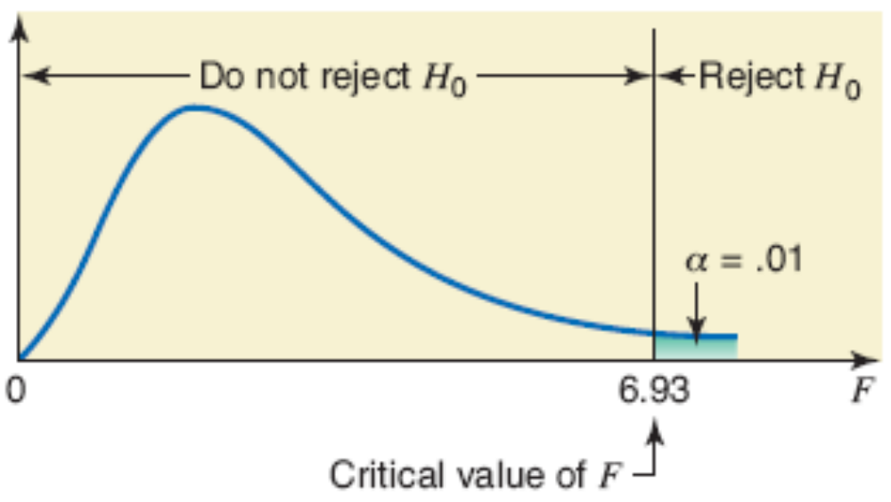
Figure 12.3 Critical value of F for df = (2,12) and α = .01.

Slide 29
Example 12-3: Solution
Step 4. Test Statistic:
As done before………..
Step 5. Decision:
The value of the test statistic F = 1.09
  It is less than the critical value of F = 6.93
  It falls in the non-rejection region
Hence, we fail to reject the null hypothesis
Step 6: We conclude that the means of the three populations are equal.

Slide 30
R code
score<-c(48,73,51,65,87,55,85,70,69,90,84,68,95,74,67)
length(score)
method<-c("M1","M1", "M1", "M1", "M1", "M2","M2", "M2", "M2", "M2","M3","M3", "M3", "M3", "M3")
aov<- aov(score ~ method)
summary(aov)

Slide 31
Example 12-4
From time to time, unknown to its employees, the research department at Post Bank observes various employees for their work productivity. Recently this department wanted to check whether the four tellers at a branch of this bank serve, on average, the same number of customers per hour. The research manager observed each of the four tellers for a certain number of hours. The following table gives the number of customers served by the four tellers during each of the observed hours.

Slide 32
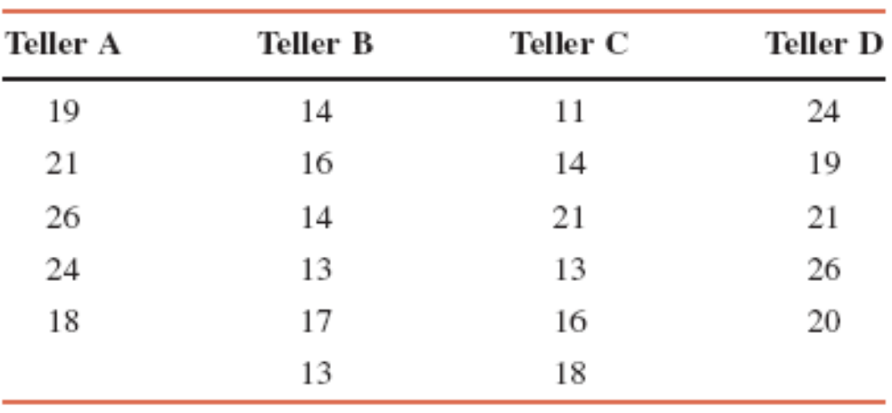
Example 12-4

Slide 33
Example 12-4
At the 5% significance level, test the null hypothesis that the mean number of customers served per hour by each of these four tellers is the same. Assume that all the assumptions required to apply the one-way ANOVA procedure hold true.

Slide 34
Example 12-4: Solution
Step 1:
H₀: μ₁ = μ₂ = μ₃ = μ₄ (The mean number of customers served per hour by each of the four tellers is the same)
H₁: Not all four population means are equal

Slide 35
Example 12-4: Solution
Step 2: F distribution

Slide 36
Example 12-4: Solution
Step 3:
α = .05.
A one-way ANOVA test is always right-tailed.
Area in the right tail is .05.
df for the numerator = k – 1 = 4 – 1 = 3
df for the denominator = n – k = 22 – 4 = 18

Slide 37
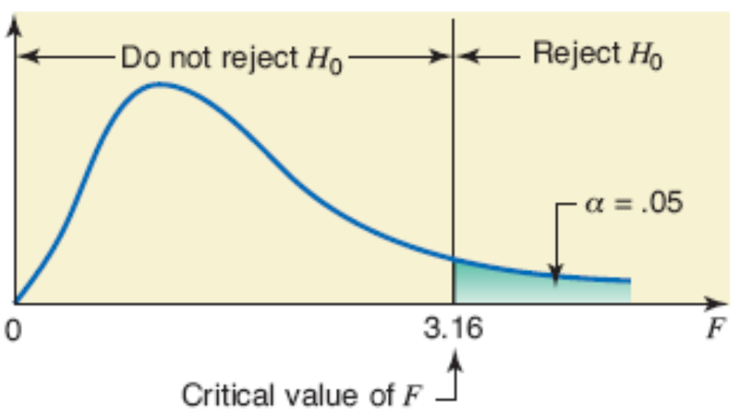
Figure 12.4 Critical value of F for df = (3, 18) and α = .05.

Slide 38
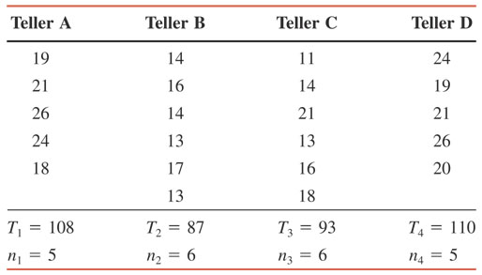
Table 12.5

Slide 39
Example 12-4: Solution
Step 4:
Σx = T₁ + T₂ + T₃ + T₄ =108 + 87 + 93 + 110 = 398
n = n₁ + n₂ + n₃ + n₄ = 5 + 6 + 6 + 5 = 22
Σx² = (19)² + (21)² + (26)² + (24)² + (18)² + (14)² + (16)² + (14)² + (13)² + (17)² + (13)² + (11)² + (14)² + (21)² + (13)² + (16)² + (18)² + (24)² + (19)² + (21)² + (26)² + (20)²
= 7614

Slide 40
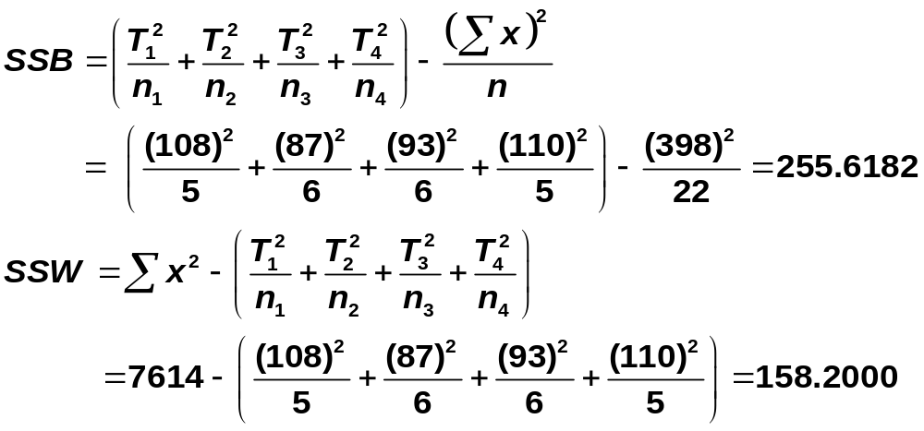
Example 12-4: Solution

Slide 41
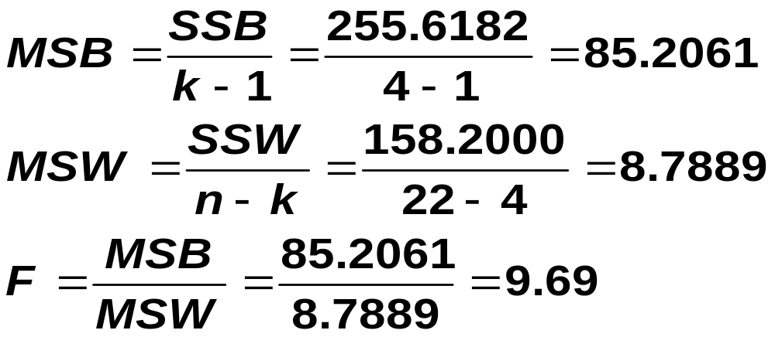
Example 12-4: Solution

Slide 42
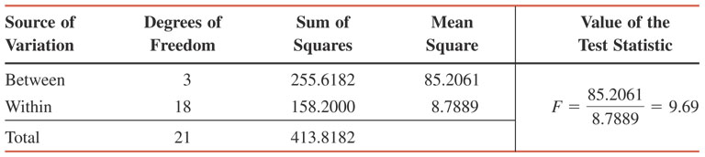
Table 12.6 ANOVA Table for Example 12-4

Slide 43
Example 12-4: Solution
Step 5: Decision
The value for the test statistic F = 9.69
  It is greater than the critical value of F = 3.16
  It falls in the rejection region
Consequently, we reject the null hypothesis
Step 6: Conclusion:
We conclude that the mean number of customers served per hour by each of the four tellers is not the same.

Slide 44
R code
score<-c(48,73,51,65,87,55,85,70,69,90,84,68,95,74,67)
length(score)
method<-c("M1","M1", "M1", "M1", "M1", "M2","M2", "M2", "M2", "M2","M3","M3", "M3", "M3", "M3")
aov<- aov(score ~ method)
summary(aov)

